Slide 1
ISO27001:2013 Controls Appendix; Part 4
In this module lets look at ISO27001:2013 (ISMS) related to access control ….

Slide 2

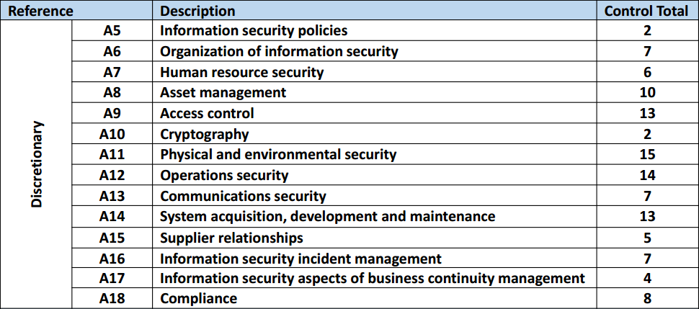
ISO27001:2013 Controls Appendix; Part 4
ISO27001:2013 DISCRETIONARY CONTROLS
TOTAL: 114
https://chapters.theiia.org/bermuda/Events/ChapterDocuments/Information%20Security%20Management%20System%20%28ISMS%29%20Overview.pdf

Slide 3
ISO27001:2013 Controls Appendix; Part 4
A.9 ACCESS CONTROL
A.9.1 BUSINESS REQUIREMENTS OF ACCESS CONTROL
A.9.1.1 | ACCESS CONTROL POLICY
A.9.1.2 | ACCESS TO NETWORKS AND NETWORK SERVICES

Slide 4
ISO27001:2013 Controls Appendix; Part 4
A.9 ACCESS CONTROL
A.9.1.2 | ACCESS TO NETWORKS & NETWORK SERVICES | Control: Users shall only be provided with access to the network and network services that they have been specifically authorized to use.

Slide 5
ISO27001:2013 Controls Appendix; Part 4
A.9 ACCESS CONTROL
A.9.2 USER ACCESS MANAGEMENT
A.9.2.1 | USER REGISTRATION & DE-REGISTRATION
A.9.2.2 | USER ACCESS PROVISIONING
A.9.2.3 | MNGMT OF PRIVILEGED ACCESS RIGHTS
A.9.2.4 | MANAGEMENT OF SECRET AUTHENTICATION INFO OF USERS
A.9.2.5 | REVIEW OF USERS ACCESS RIGHTS
A.9.2.6 | REMOVAL OR ADJUSTMENT OF ACCESS RIGHTS

Slide 6
ISO27001:2013 Controls Appendix; Part 4
A.9 ACCESS CONTROL
A.9.2.3 | MANAGEMENT OF PRIVILEGED ACCESS RIGHTS | Control: The allocation and use of privileged access rights shall be restricted and controlled.

Slide 7
ISO27001:2013 Controls Appendix; Part 4
A.9 ACCESS CONTROL
A.9.2.5 | REVIEW OF USER ACCESS RIGHTS | Control: Asset owners shall review users’ access rights at regular intervals.

Slide 8
ISO27001:2013 Controls Appendix; Part 4
A.9 ACCESS CONTROL
A.9.2.6 | REMOVAL OR ADJUSTMENT OF ACCESS RIGHTS | Control: Access rights of all employees and external party users to info & info processing facilities shall be removed upon termination of their employment, contract or agreement, or adjusted upon change.

Slide 9
ISO27001:2013 Controls Appendix; Part 4
A.9 ACCESS CONTROL
A.9.3 USER RESPONSIBILITIES
A.9.3.1 | USE OF SECRET AUTHENTICATION INFORMATION

Slide 10
ISO27001:2013 Controls Appendix; Part 4
A.9 ACCESS CONTROL
A.9.3.1 | USE OF SECRET AUTHENTICATION INFORMATION | Control: Users shall be required to follow the organization’s practices in the use of secret authentication information.

Slide 11
ISO27001:2013 Controls Appendix; Part 4
A.9 ACCESS CONTROL
A.9.4 SYSTEM & APPLICATION ACCESS CONTROL
A.9.4.1 | INFORMATION ACCESS RESTRICTION
A.9.4.2 | SECURE LOG-ON PROCEDURES
A.9.4.3 | PASSWORD MANAGEMENT SYSTEM
A.9.4.4 | USE OF PRIVILEGED UTILITY PROGRAMS
A.9.4.5 | ACCESS CONTROL TO PROGRAM SOURCE CODE

Slide 12
ISO27001:2013 Controls Appendix; Part 4
A.9 ACCESS CONTROL
A.9.4.3 | PASSWORD MANAGEMENT SYSTEM | Control: Password management systems shall be interactive and shall ensure quality passwords.
A.9.4.5 | ACCESS CONTROL TO PROGRAM SOURCE CODE | Control: Access to program source code shall be restricted.

Slide 13
ISO27001:2013 Controls Appendix; Part 4
Lets look at cryptography, and physical & environmental security in the next module…
END

